Slide 1
Birmingham Biomechanics Laboratory
The Birmingham Biomechanics Laboratory is directed by Dr. Ziyun Ding. Our mission is to employ cutting-edge experimental and computational techniques in designing patient-centered interventions and devices, aiming to enhance the quality of life for people with neuromuscular disorders.
CONTACT US
Birmingham Biomechanics Laboratory
Y3, Old School of Engineering Building
Edgbaston Campus, University of Birmingham
B15 2TT
z.ding@bham.ac.uk

Slide 2
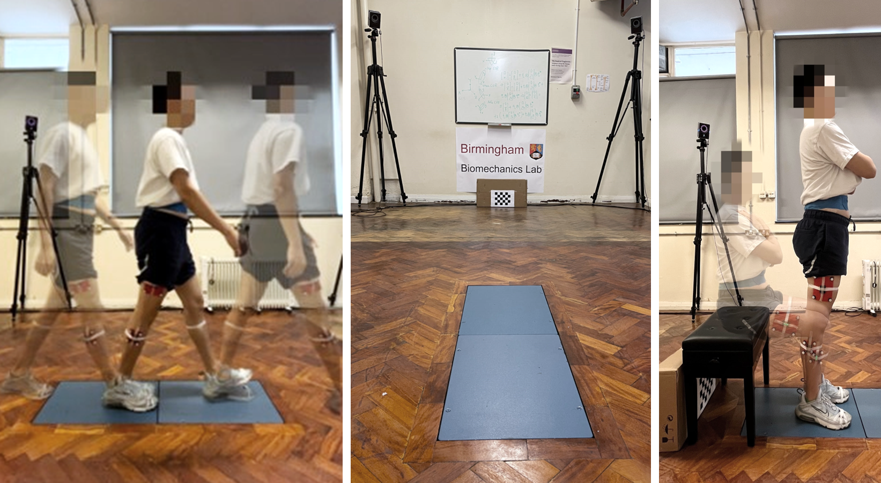
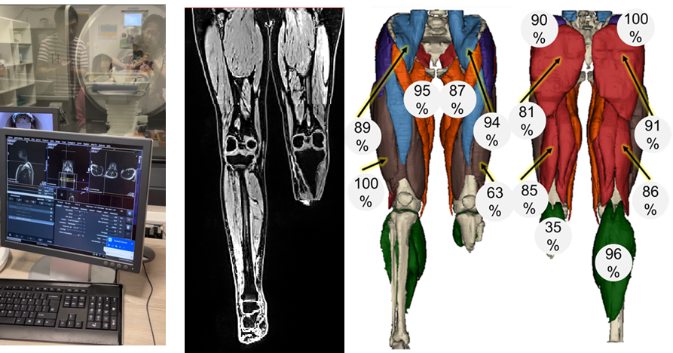
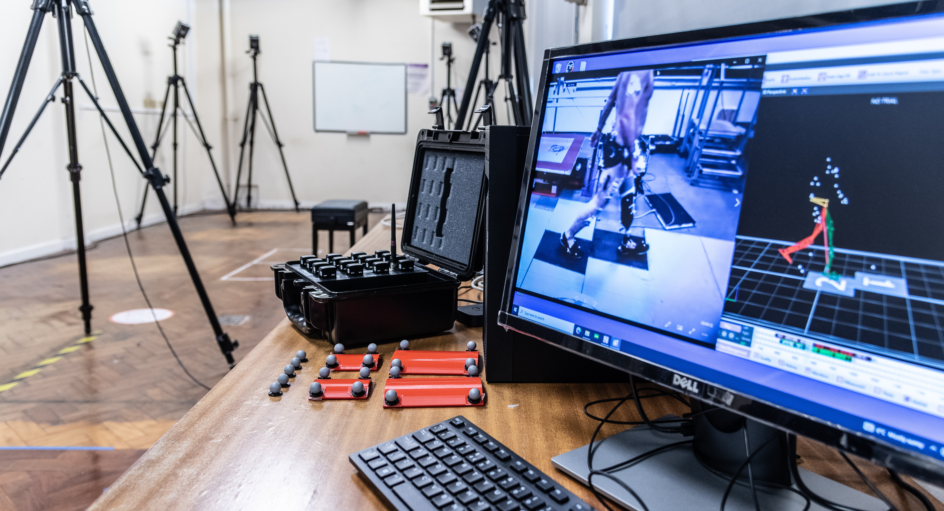
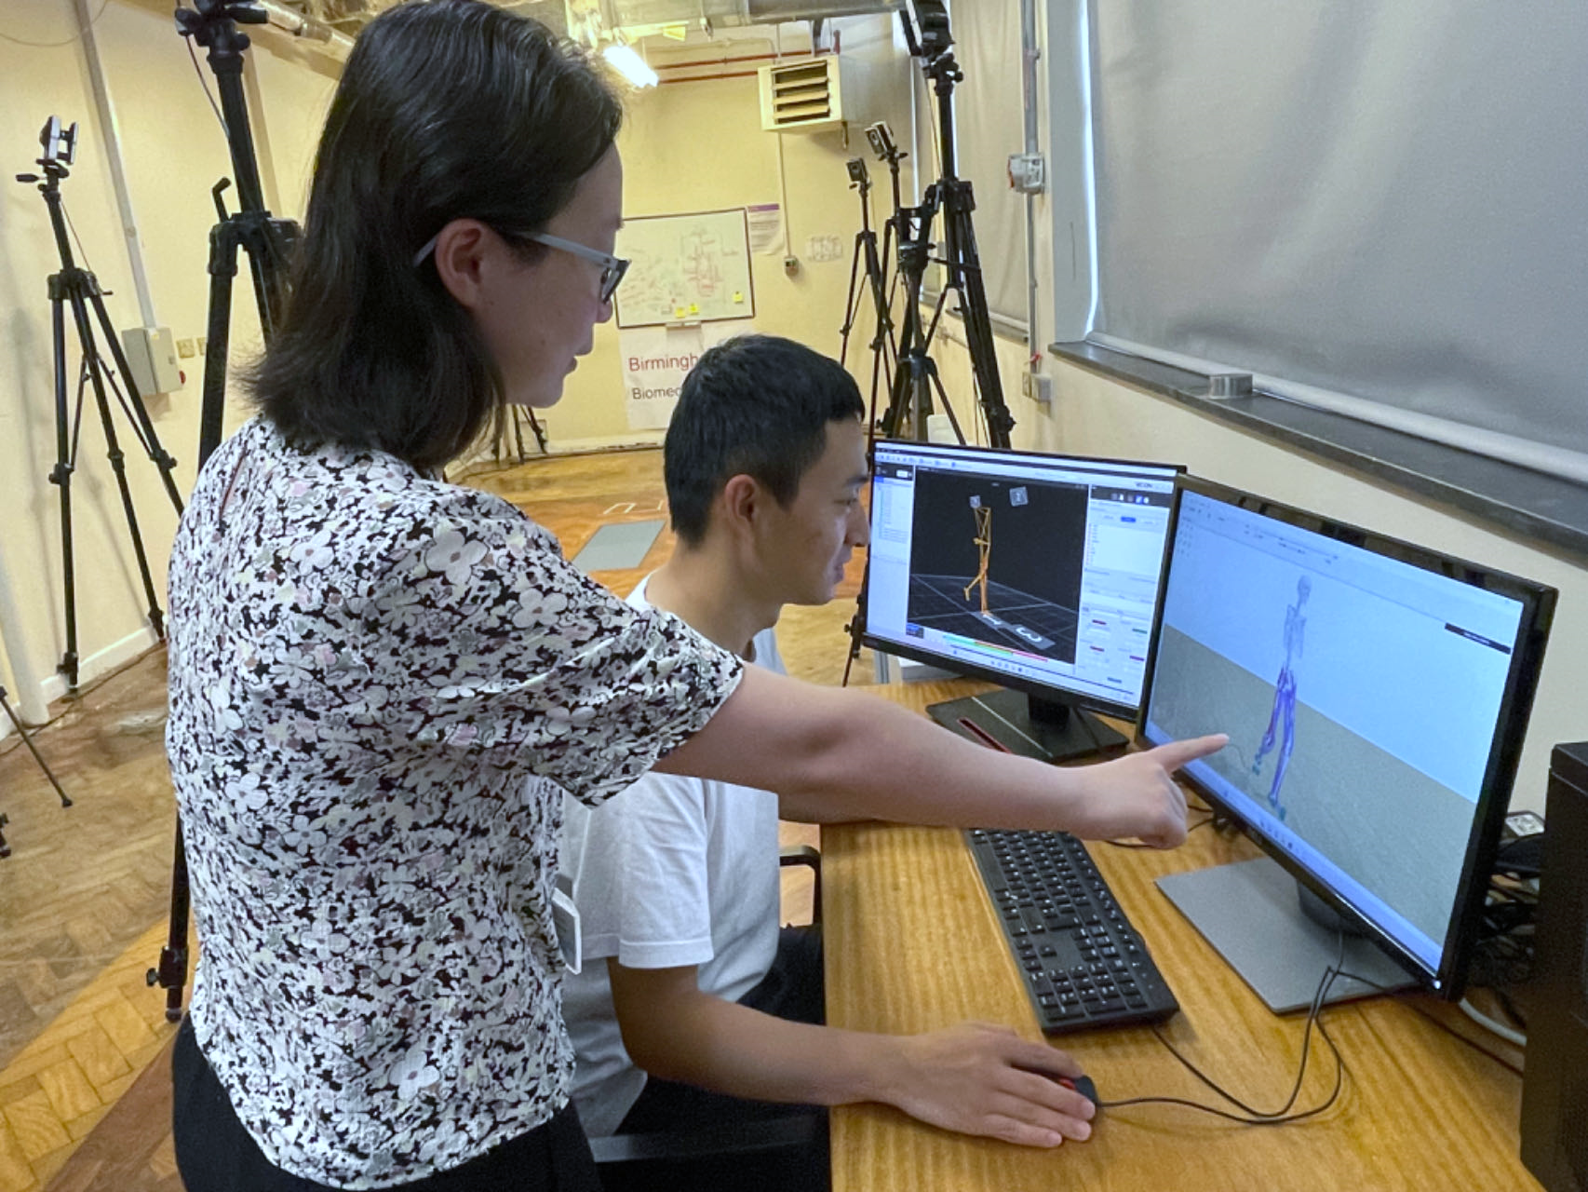
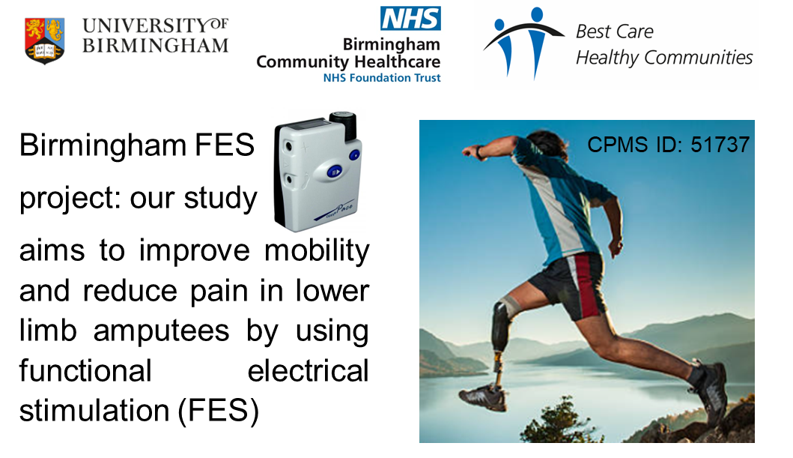
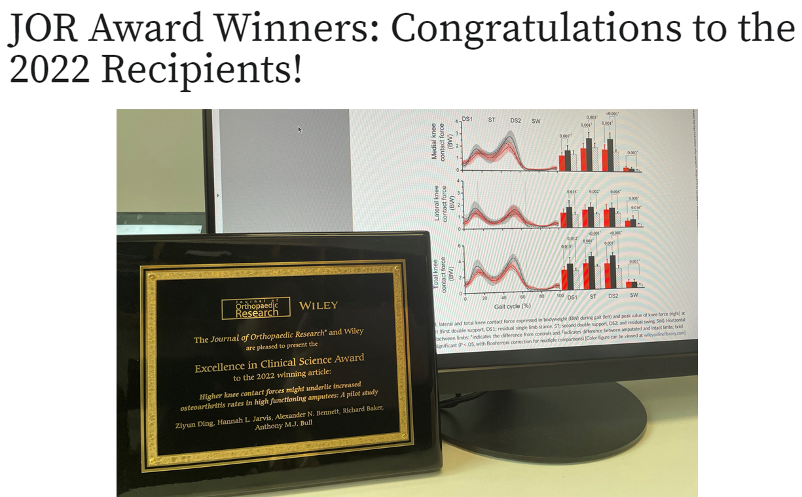
Our Research

Slide 3
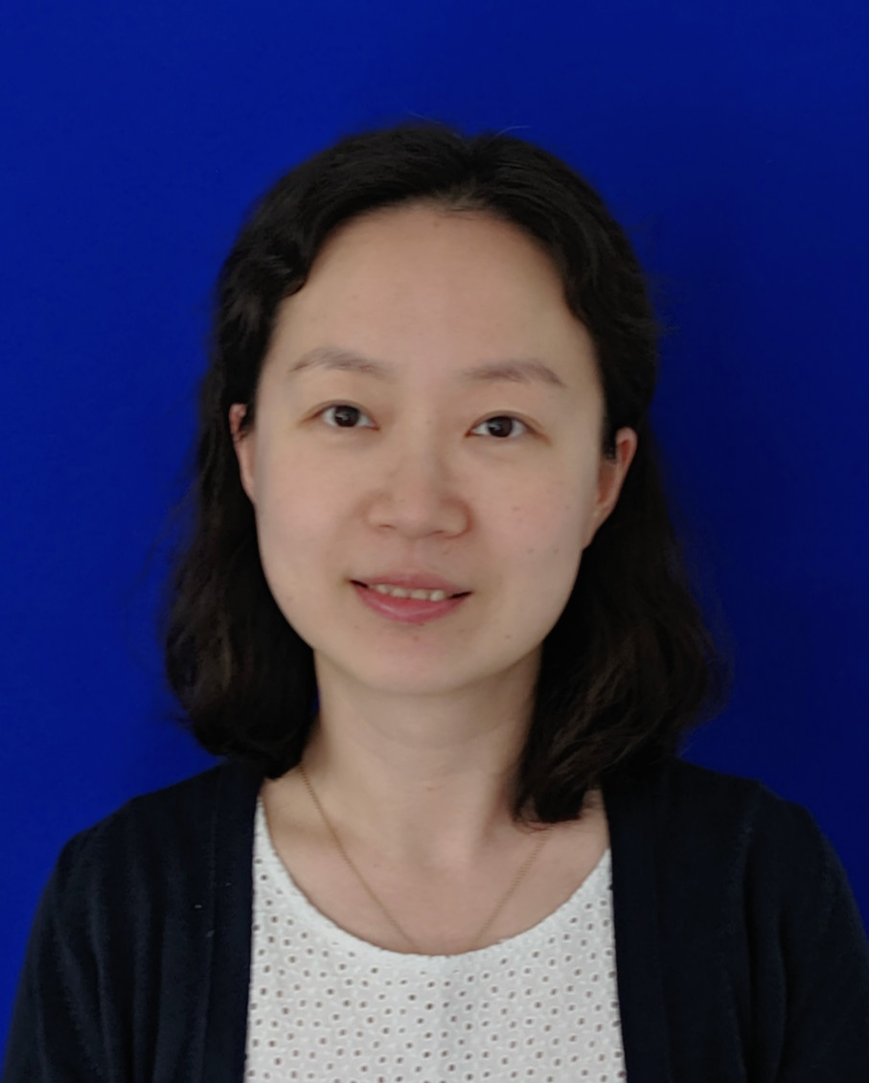
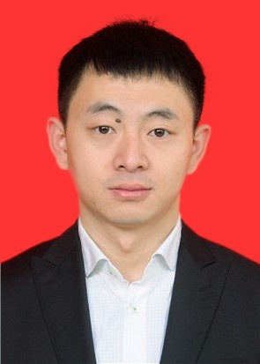
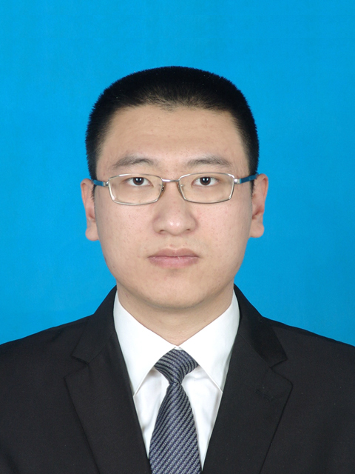

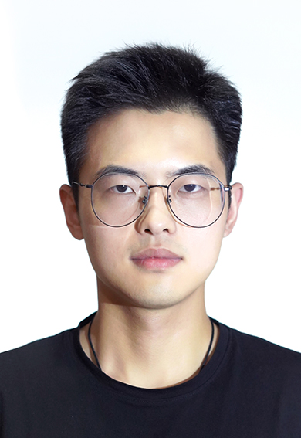
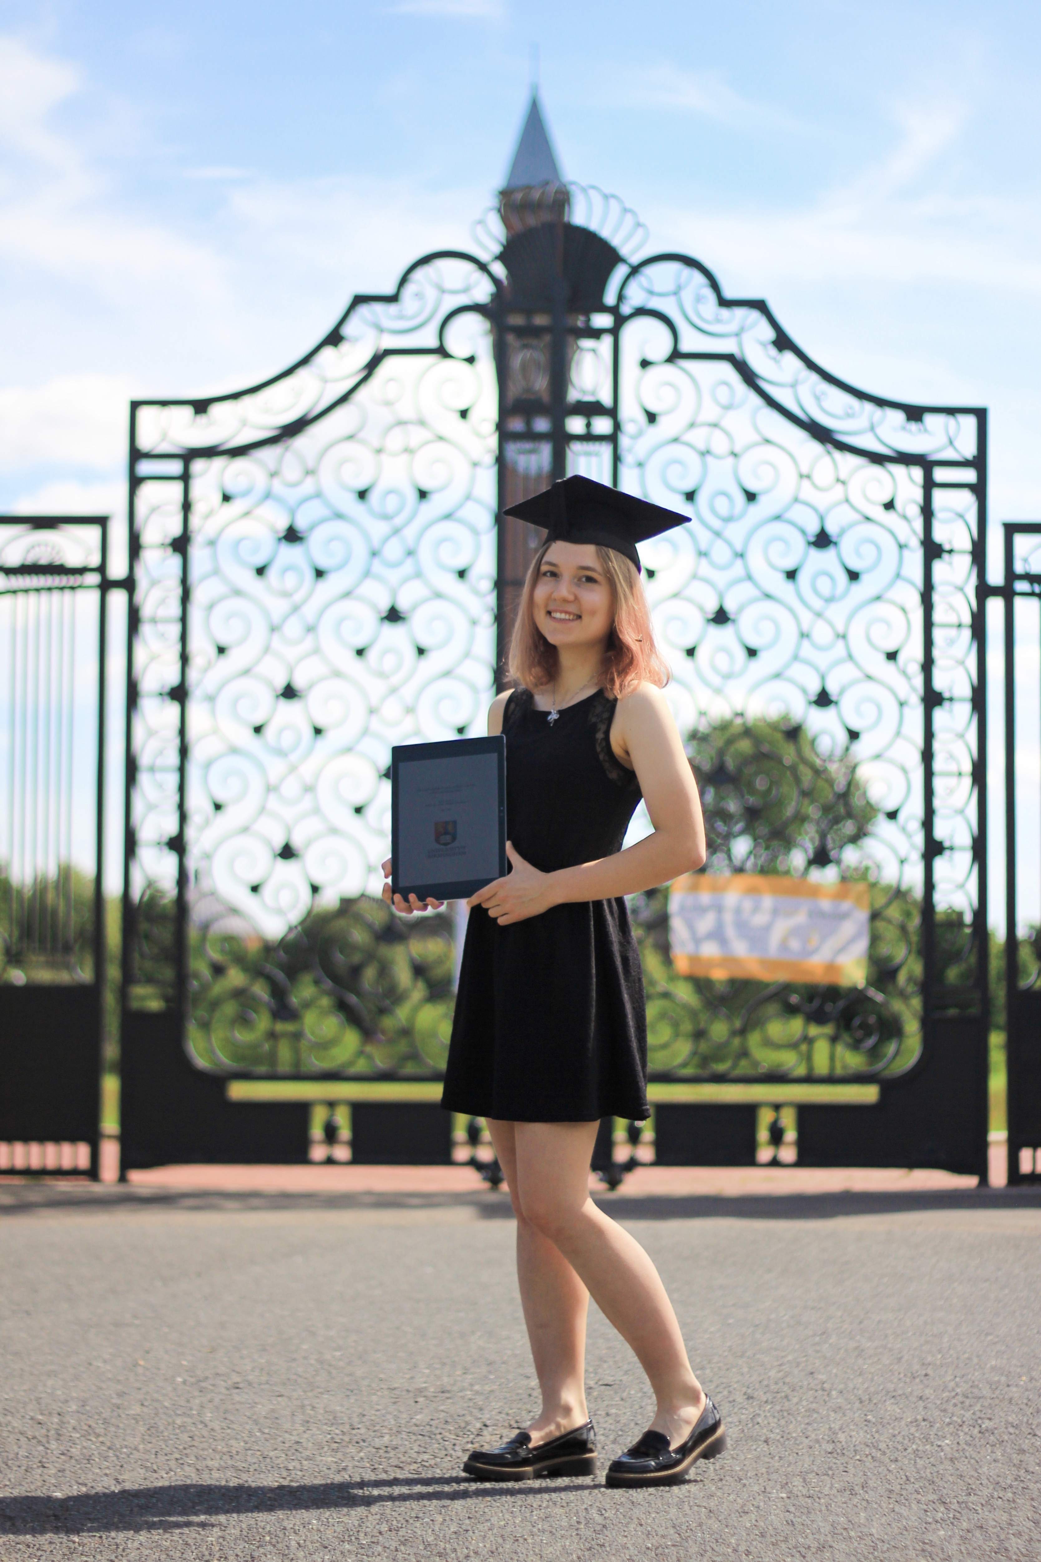
Dr Ding
Dr Hu
Mr Wang
Mr Alsayed
Mr Bian
Miss Ptaszyk
(2023 Autumn)

